Slide 1

Airbnb prediction
Team 4:
Baabi Felli, Kaitlyn Keebaugh, Tanya Lewis, Daniel McClung, & Nicholas Waine

Slide 2

Goals
AIRBNB has a great deal of data on rental properties and rental prices.
Our primary goal is to create a predictive model to aid property owners in setting rental prices.
Our secondary goal is to generate recommendations on additional data to capture and improve the model.

Slide 3
Data
Size
The data set was large, so we limited our initial pilot to NYC properties
The data needed some pre-work to be useful
Scrub entries with missing data
Fix date fields
Convert categorical data to dummy fields
Create new fields as needed

Slide 4
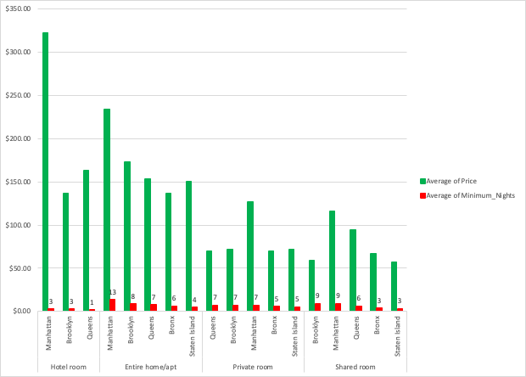
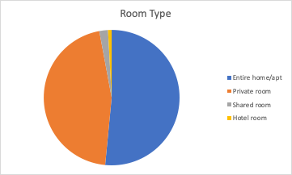
Data

Slide 5
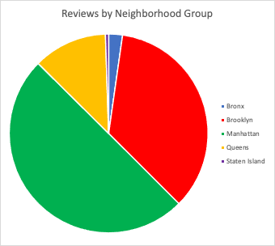
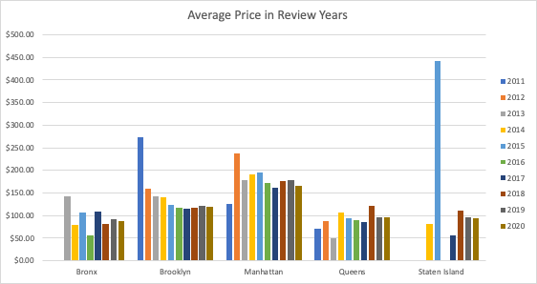
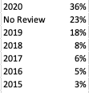
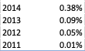
Data
Overall Average Price: $149.56
Range: $9 - $10,000

Slide 6
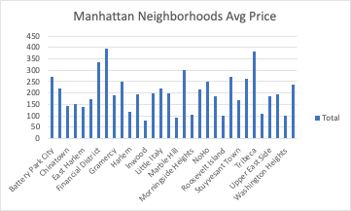
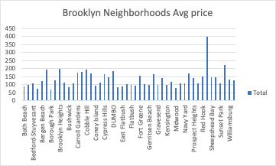
Manhattan vs Brooklyn

Slide 7
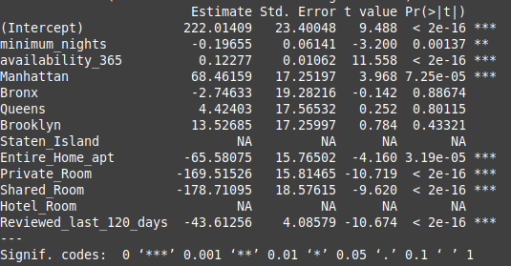
Linear Regression Model
Our first attempt was to build a linear regression model
We tried several permutations, but we continued to get poor R^2 values

Slide 8
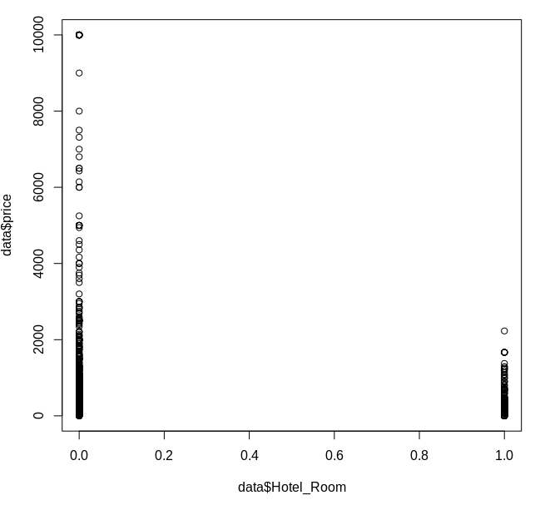
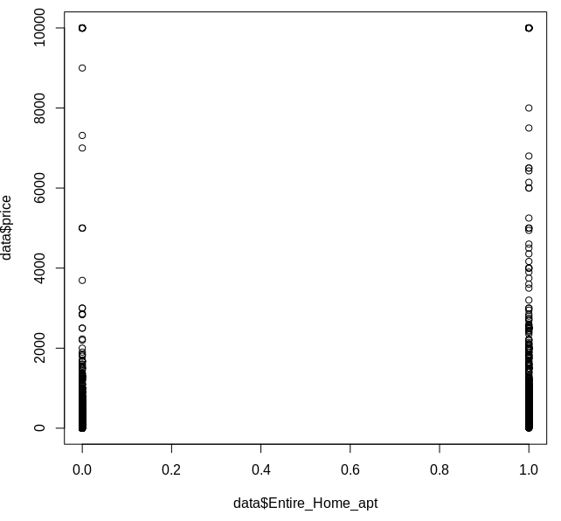
A Closer Look Binary Data

Slide 9
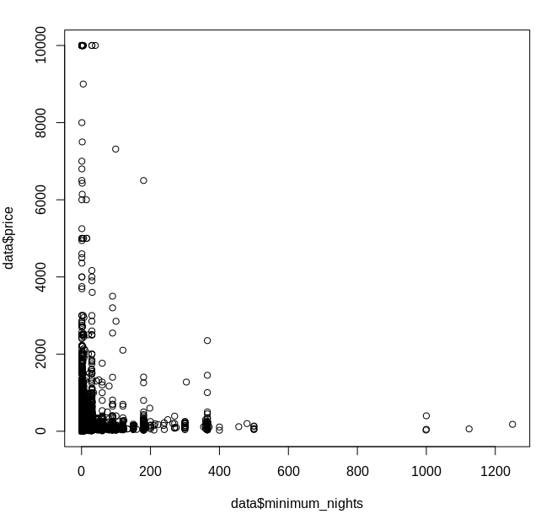
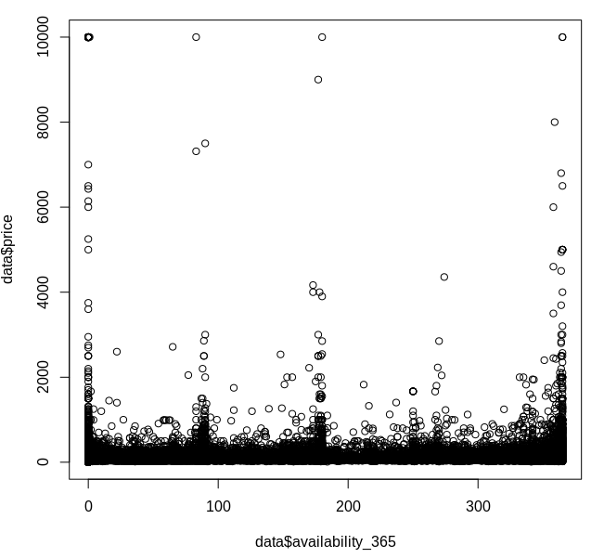
A Closer Look Continuous Data

Slide 10
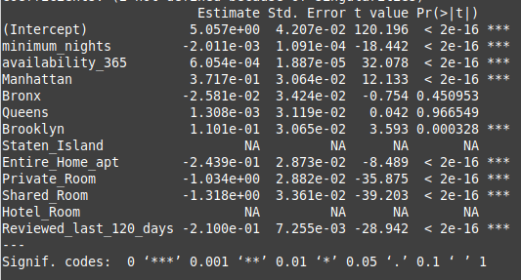
Exponential Regression Model
Better R^2, but still not sufficient
Models generated provide very weak prediction

Slide 11
Regression Conclusion
No combination of variables yielded a good fit for our data
A review of the data supports our conjecture
At this point we suspect our dataset is insufficient to predict price
But we are going to try a few other techniques

Slide 12
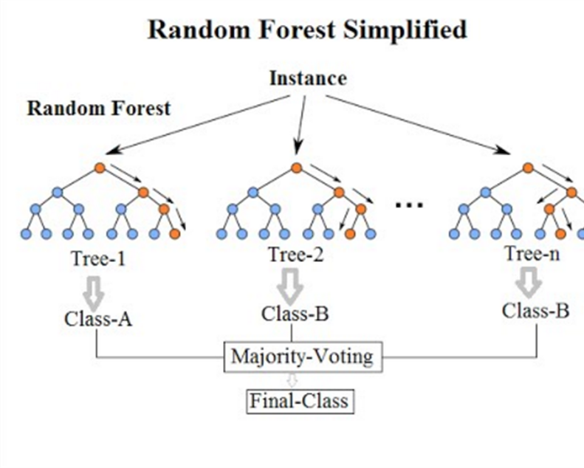
Random Forest
Random Forest is a classification algorithm known for producing accurate predictions and its ability to handle large amounts of data
The algorithm was used to try to classify listings into price categories based on attributes

Slide 13
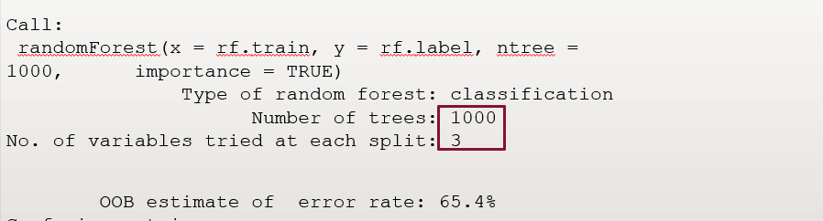
Random Forest Results
Initial hypothesis focused on neighborhood as a predictor of price, and recency/frequency of reviews
Data Preprocessing involved creating a "price category" attribute, and removing non-predictive attributes
Results showed that the data did not hold much predictive power due to the qualitative nature of price factors

Slide 14
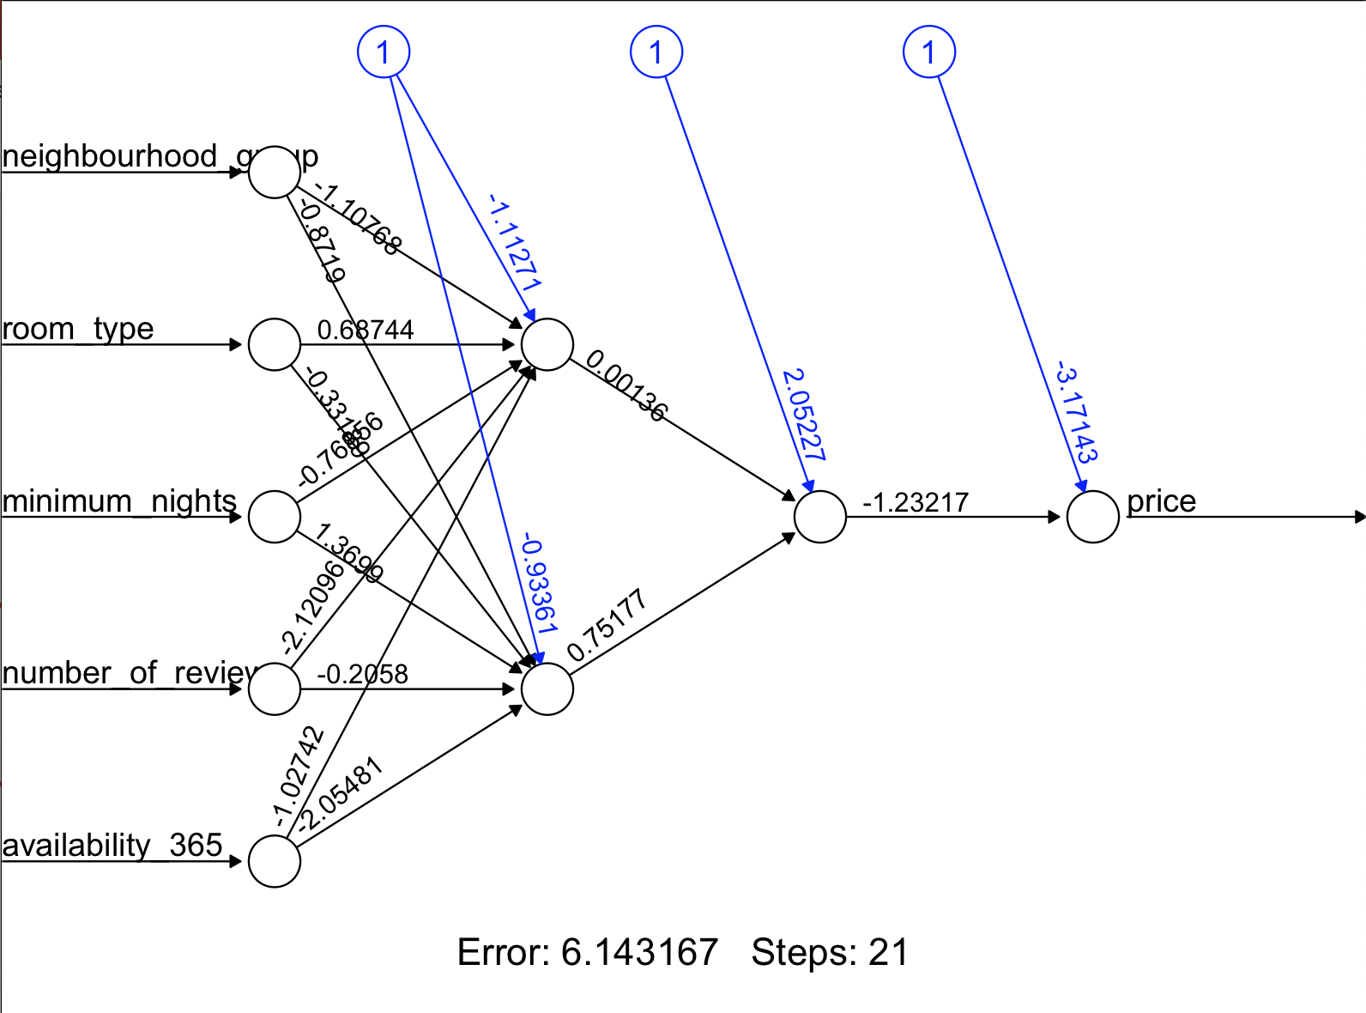
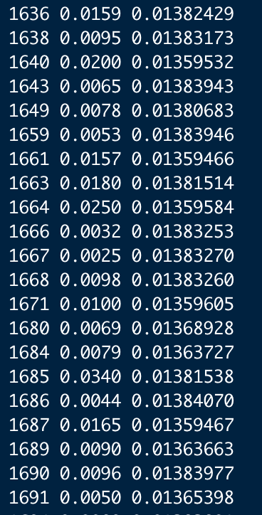
Neural Network
Wanted to have multiple ways to test our question
Neural Network takes numerical data and creates a learning process to predict the outcome (price)
1st try was a hidden node 2

Slide 15
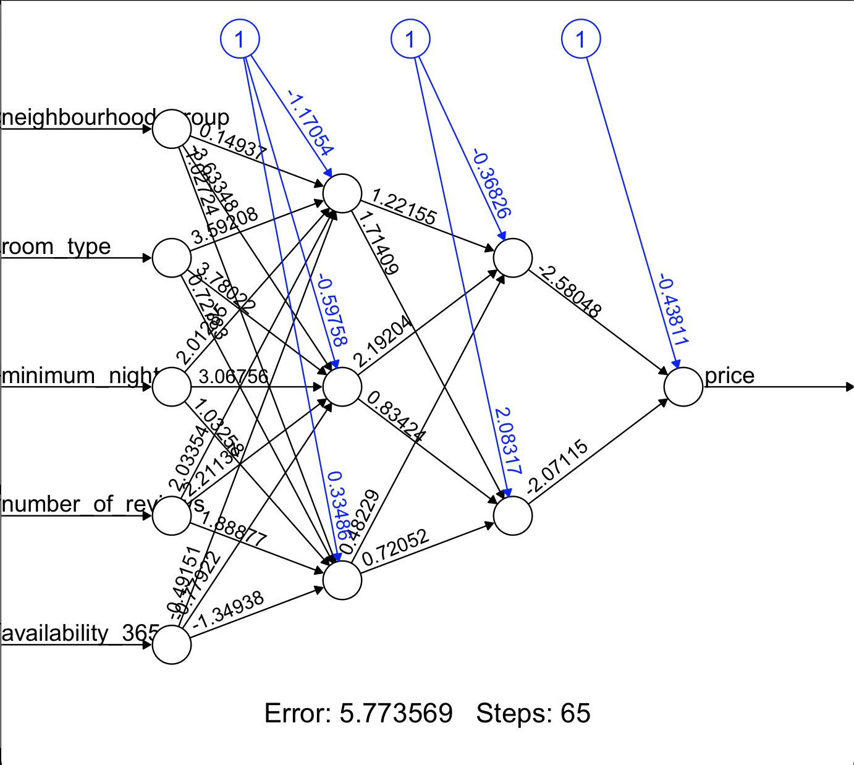
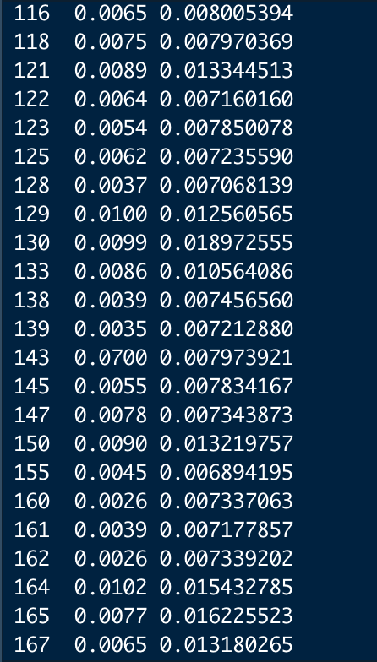
Neural Network
Reran Neural Network with 3,2 hidden nodes
Got a little less error
Answers were a little closer

Slide 16
Conclusion
All three models indicated low accuracy levels with the variables we inputted.
e.g., Neighborhood Group, Number of Nights, Availability of Rooms, Reviews, and Room Types
Data set was insufficient in providing great predictive indicators.
Missing independent variables.

Slide 17

What Airbnb Variables Do You Think may be important in predicting rental prices?

Slide 18
Seasonality
Occupancy
Luxury vs studios
Proximity to metro and other attractions
# of Photos
# of Amenities
Washer /Dryer
Wifi
Pet friendly
Number of bedrooms
Types of beds
Backyard
Square footage
Content in reviews
Host presence

Slide 19

Thank you

